Slide 1
Hand Powered Bicycle
Team 9
Murtadha Al Ismaiel
Alex Cendrowski
Nathaniel Degenhardt
Katelyn Reece
Abdullah Al Baki Sifat
Jeremy Witherspoon
Woltz Zane

Slide 2
Description of our Problem:
We had to find a way to create a bike that anyone could ride and specifically a bike that could be ridden by handicapped people. We had to design a bike that was maneuverable, accessible, and easy enough to operate for anyone.

Slide 3
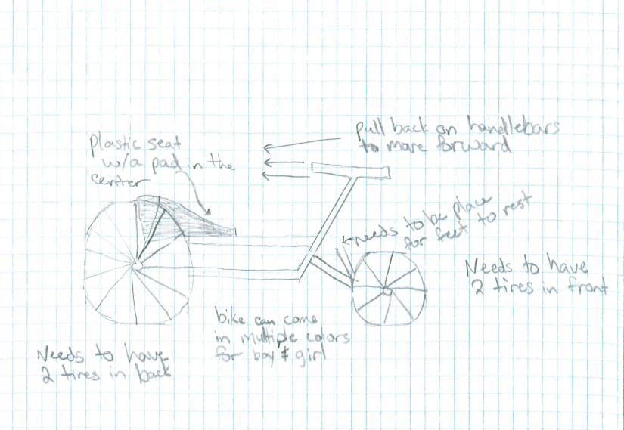
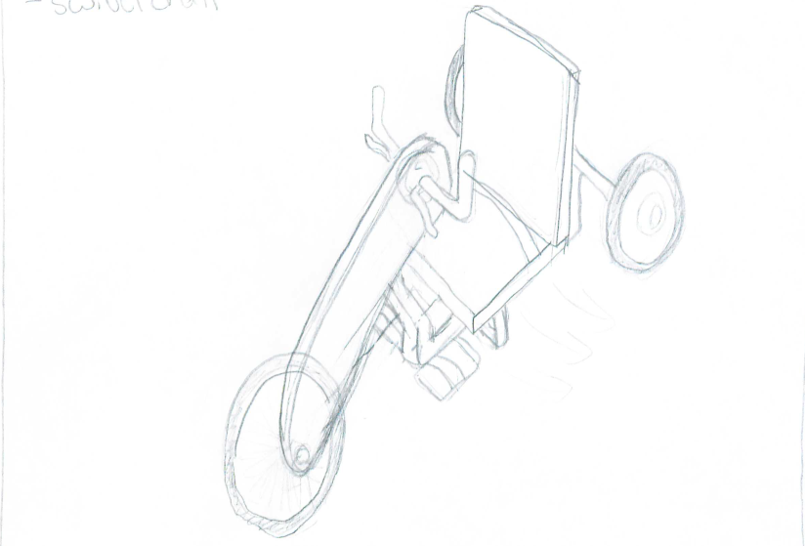
Preliminary Ideas

Slide 4
Finalized Idea
We chose this design because it fit all the criteria needed to make an accessible, maneuverable and easy to use bike.

Slide 5
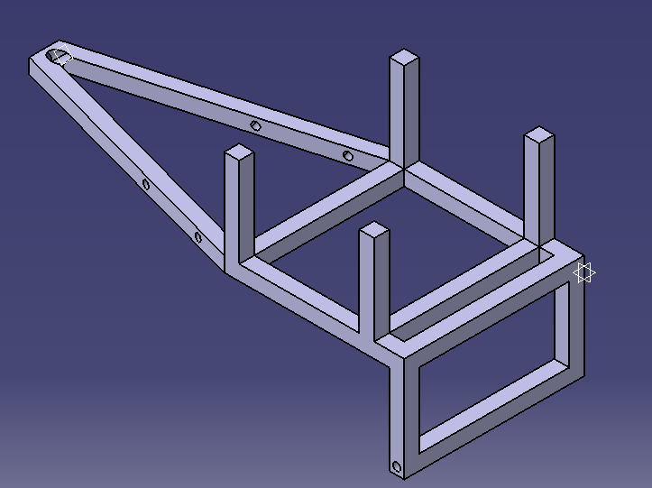
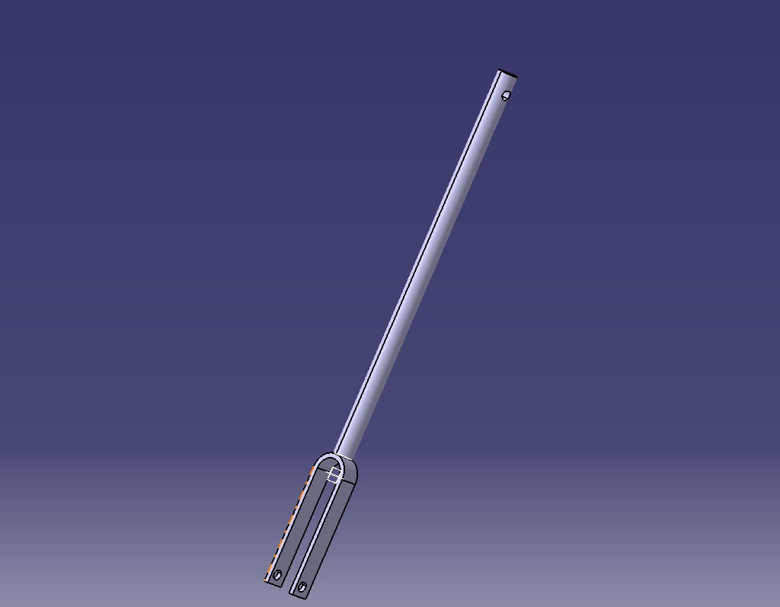
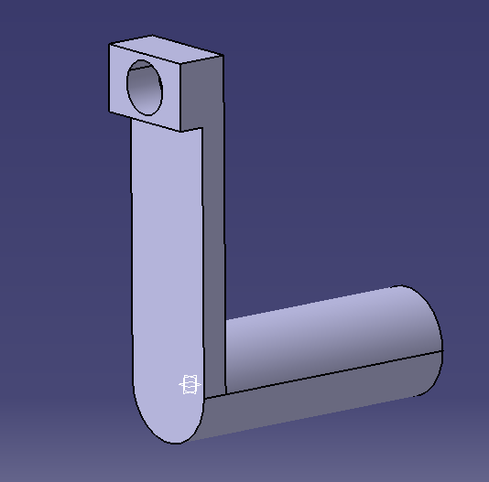
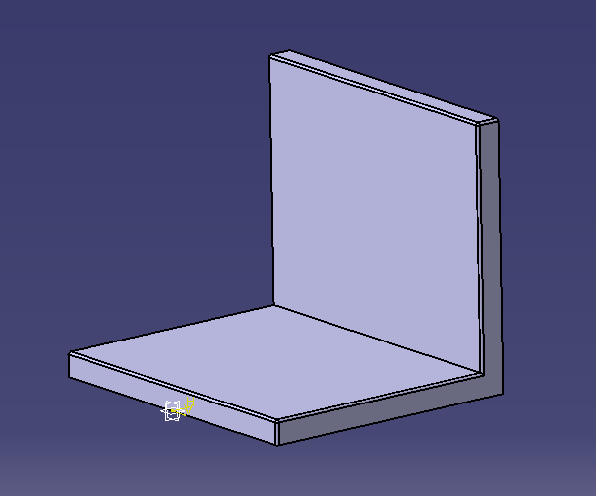
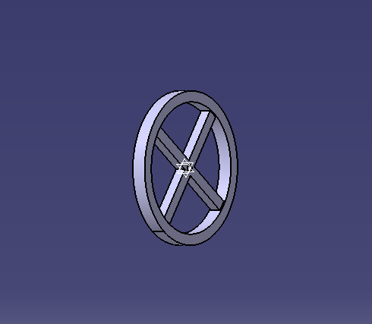
Catia Models of Bike
Frame
Shaft
Handles x2
Seat
Wheels x3

Slide 6
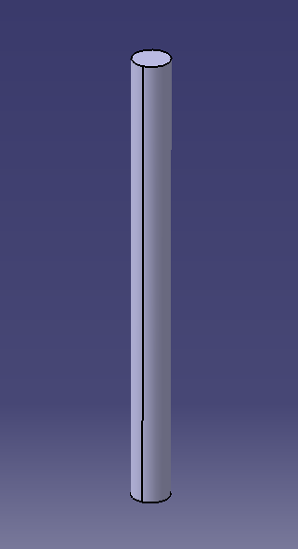
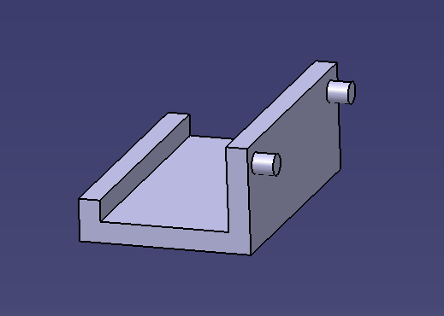
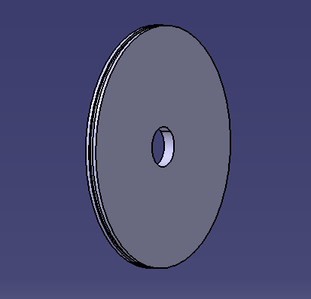
Catia Models Cont.
Stirrup x2
Axles x3
Gears x2

Slide 7
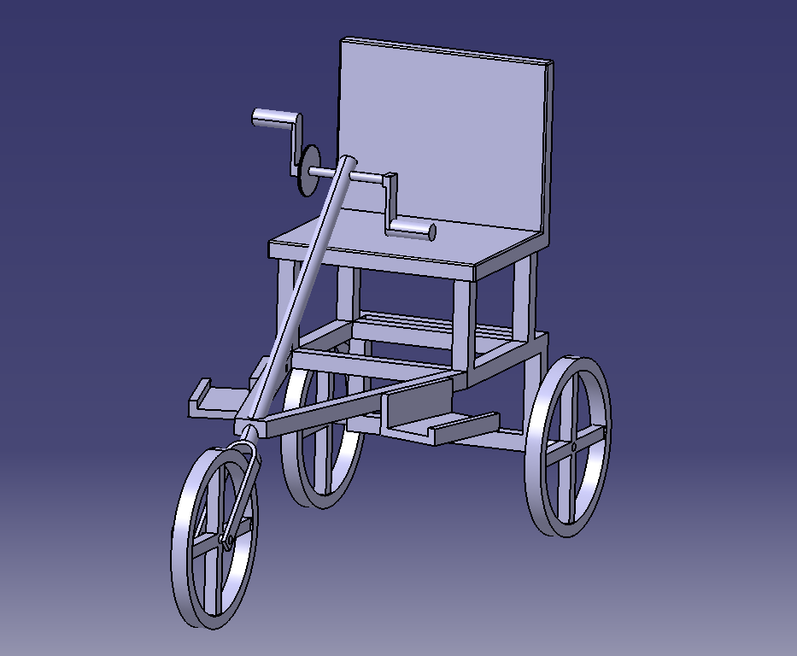
Fully Assembled Model

Slide 8
Fabrication of Design
We decided that aluminum would make up most parts of the bike ranging from the seat, frame, handles, axles, and gears while the seat would be cushioned with leather and foam, the gear belt, handle covers, and wheels would all be made from rubber.
Pros
Using aluminum would make the product both strong and lightweight
Product will be sturdy and reliable
Parts will be reliable
Cons
Aluminum not quite as strong as other materials

Slide 9
Estimated Production Cost
Material Cost
Seat, Handles, Frame, axles, gear $30.80
Gear Belt $25.00
Seat topping $69.95
Handle Covers $16.00
Wheel Tires $38.97
Total Cost $180.72

Slide 10
Marketing the Product
Marketing the product is extremely important and to market an item that is for a specific buyer makes marketing even more important.
Internet
This will be one of the biggest ways to market the product, as people can search for the bike or find out about our bike from related websites.
Specialty stores or bike shops
Being able to keep our product where people will see or experience our problem would be a great place to have it and market it.
Sporting Goods
Putting our product in stores like Dick’s sporting goods could be a way to open our product to people who might not see it otherwise.

